Slide 1
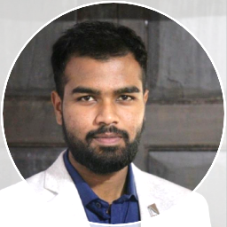


Md Ubaid Aslam Sheikh
Analyst/ Software Engineer
(Developer)
Bachelor of Technology
Production Engineering: 2018 - 2021
Skills C#
PowerShell
MVC
Asp.net
Certifications
Azure Certified
Agile Software Development
Introduction to Python
Azure Certifications
AZ-900, AZ-104, AZ-204
AZ-400, AZ-500, AZ-305
AddOns
Jira
Confluence
Additional Details
Leadership
Team management
Quick Learner
Pune
md-ubaid-aslam.sheikh@capgemini.com
9175282915
A4
Developer who is strong in logical thinking and integration with intuitive problem-solving skills. Passionate about implementing and launching new projects.
Azure Certified, ‎.Net, C#, Powershell, Software Developer. Worked on projects with technologies like Asp.net Api, MVC, SQL server, ADO.net, Web services, Web API, HTML, CSS. Worked with scrum and agile in project.
Ready to learn new technologies and implement them to further improve my knowledge.
Eager to work in a team of dedicated people and serve a key role in the enhancement and development of the project.
Has working knowledge for Desktop Application from development to production on C#, .Net and PowerShell.
Capgemini – Delivery Excellence Award 2022
Received Delivery Excellence Award for focusing and ensuring all deliverables are absolute and understanding program nuances.
Other
Prize at Anveshna Project Competition, Mumbai
Issued by Synopsys and Agastya International Foundation · Feb 2020
Best Outgoing Student
Issued by DYP Polytechnic Kolhapur · Feb 2018
Publications
Fatigueless Powder Fertilizer Dropper
International Research Journal of Engineering and Technology · Nov 30, 2021
3 in 1 Multi-Utility Material Handling System
International Research Journal of Engineering and Technology · Jun 1, 2020
For more details -

